Slide 1

CS415: Databases

Slide 2
Lesson 12
Performance Optimization Strategies for MongoDB – Replication and Sharding

Slide 3
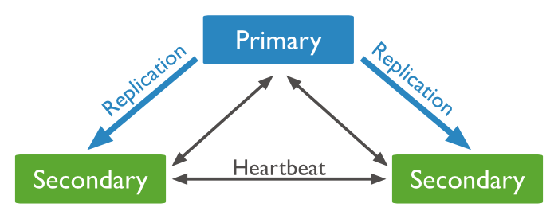
Replication
MongoDB has the capability to be fail tolerance with high availability. That's because of its advanced replication features which allow us to setup multiple nodes (one Primary and many Secondary) that will be automatically replicated asynchronously.
Replica Set
Set of Mongo Nodes

Slide 4
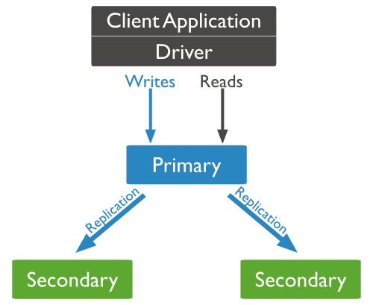
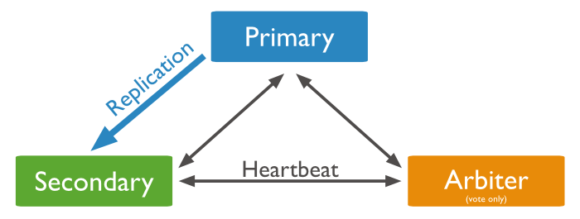
Replica Set
Our application (Mongo Driver) always talk to the Primary Node. Perform writes operations to it or read operations from it.
When the Primary node goes down, Secondary nodes will perform an election to elect a new Primary node based on the majority of original number of nodes (transparent to the application).
We must at least have 3 nodes in a Replica Set.
Types of Replica Set nodes
Regular Node (primary, secondary)
Arbiter Node (for voting purposes, if we have two machines only)
Delayed Node (disaster node, set a time behind other nodes)
Hidden Node (for analytics)
All nodes can participate in the election and can vote but only regular nodes can become a Primary node.

Slide 5
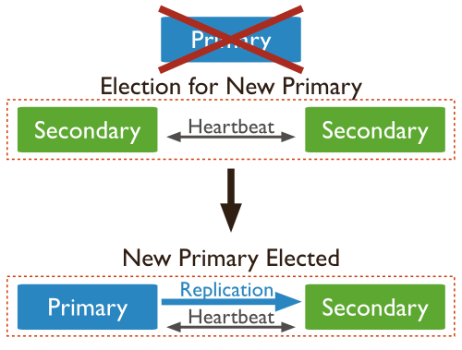
Replication Write Concerns
The MongoDB Driver will only write to the Primary node.
During the time of failover you cannot perform/complete a write because there is no Primary node and the new Primary node has not been elected yet. All write operations will be buffered in the Driver until one of the Secondary nodes is elected as Primary then the callback will be called and response will be received.
We can configure the write concerns to be:
(w:0) which mean return success immediately
(w:1) return success only until Primary successfully writes
(w:2) return success only until Primary and one Secondary successfully writes
What happens when the Primary fails?
When the failed Primary node rejoin the Replica Set it will join as Secondary, It will sync itself with the existing new Primary. If there was any operations that has been applied to it before failure and wasn't synched to the other nodes they will be rolled back and put in file.
Notes:
What happens when the Primary fails? Cluster fails.. Can't have election again! A replicaset of 3 nodes can only recover once.. If we want to recover more than one time then we need to have a replicaset of 4,5.. nodes
if we specify a write concern larger than the number of nodes we currently have: The write waits forever.
var MongoClient = require('mongodb').MongoClient;
MongoClient.connect("mongodb://localhost:30001,localhost:30002,localhost:30003/course?w=1", function(err, db) {
if (err) throw err;
// Write concern of one
db.collection("repl").insert({ 'x' : 1 }, function(err, doc) {
if (err) throw err;
console.log(doc);
// Write concern of two
db.collection("repl").insert({ 'x' : 2 }, { 'w' : 2 }, function(err, doc) {
if (err) throw err;
console.log(doc);
db.close();
});
});
});

Slide 6
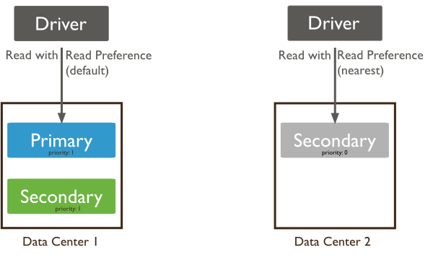
Replication Read Preferences
The MongoDB driver can be configured to read from Primary or Secondary or Nearest node.
Reading from the primary is more reliable and guarantee that applications will always read fresh data, while reading from Secondary can be stale as it might not be synched yet, but it could be faster when Primary is busy.
Notes:
Nearest node can be configured.
var MongoClient = require('mongodb').MongoClient;
ReadPreference = require('mongodb').ReadPreference;
MongoClient.connect("mongodb://localhost:30001,localhost:30002,localhost:30003/course?readPreference=secondary", function(err, db) {
if (err) throw err;
db.collection("repl").insert({ 'x' : 1 }, function(err, doc) {
if (err) throw err;
console.log(doc);
});
function findDocument() {
//db.collection("repl").findOne({ 'x' : 1 }, { 'readPreference' : ReadPreference.PRIMARY }, function(err, doc) {
db.collection("repl").findOne({ 'x' : 1 }, function(err, doc) {
if (err) throw err;
console.log(doc);
});
console.log("Dispatched find");
setTimeout(findDocument, 1000);
}
findDocument();
});

Slide 7
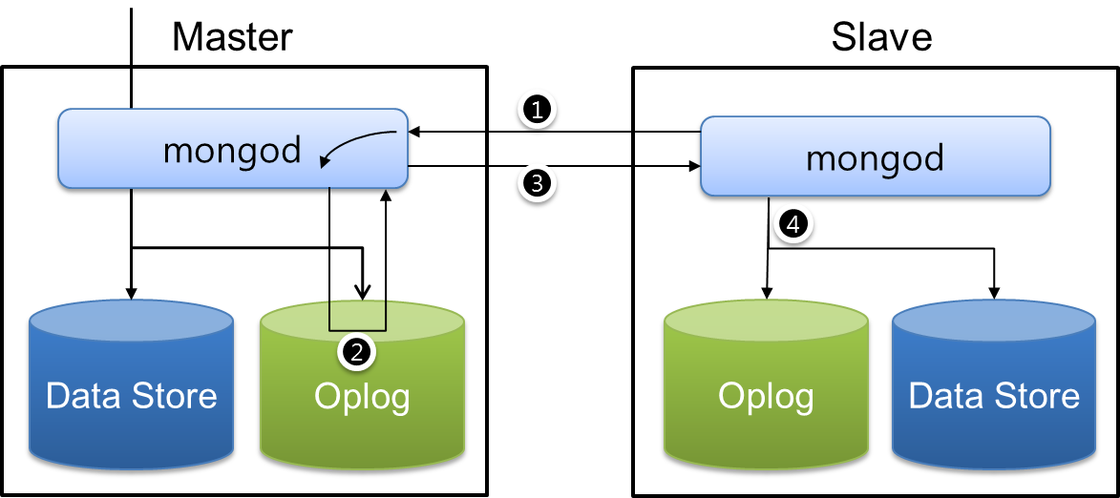
How Replication Really Works?
Oplog (operations log) is the heart of a MongoDB Replica Set. It is a special capped-collection that keeps a rolling record of all operations that modify the data stored in your databases.
MongoDB applies database operations on the primary and then records the operations on the primary's oplog.
All Secondary nodes will read and sync themselves with oplog collection.
citsoft
Capped collections are fixed-size collections that support high-throughput operations that insert and retrieve documents based on insertion order. Capped collections work in a way similar to circular buffers: once a collection fills its allocated space, it makes room for new documents by overwriting the oldest documents in the collection.

Slide 8
Working with Replications in Node.js
const MongoClient = require('mongodb').MongoClient;
const client = new MongoClient('mongodb://localhost:30001,localhost:30002,localhost:30003/testDB?w=1&readPreference=secondary’);
client.connect(function(err) {
const db = client.db('myDB’);
const collection = db.collection('myCollection’);
...
});
Set Read Preferences
Set Write Concerns to 1
return success only after Primary successfully writes
If you leave a Replica Set node out of the Seed List within the Driver, the missing node will be discovered as long as you list at least one valid node.
Notes:
#!/usr/bin/env bash
mkdir -p /data/rs1 /data/rs2 /data/rs3
mongod --replSet m101 --logpath "1.log" --dbpath /data/rs1 --port 27017 --oplogSize 64 --fork –smallfiles
mongod --replSet m101 --logpath "2.log" --dbpath /data/rs2 --port 27018 --oplogSize 64 --smallfiles --fork
mongod --replSet m101 --logpath "3.log" --dbpath /data/rs3 --port 27019 --oplogSize 64 --smallfiles --fork
config = { _id: "m101", members:[
{ _id : 0, host : "localhost:27017"},
{ _id : 1, host : "localhost:27018"},
{ _id : 2, host : "localhost:27019"} ]
};
rs.initiate(config);
rs.status();

Slide 9
Implications of Replication
Seed Lists
The driver needs to know about the Replica Set nodes (at least one other node)
Write concerns
Read Preferences
Errors can happen
An operation might be written successfully in the Primary node and DB will send a success write feedback to the Driver but a TCP reset might occur and the client might not know about it (Always catch all error in your code)

Slide 10
Main Point
The advanced replication features allow us to setup multiple nodes (one Primary and many Secondary) that will be automatically replicated asynchronously. Science of Consciousness: Seek the highest first, by starting with a good foundation and building upon that.

Slide 11
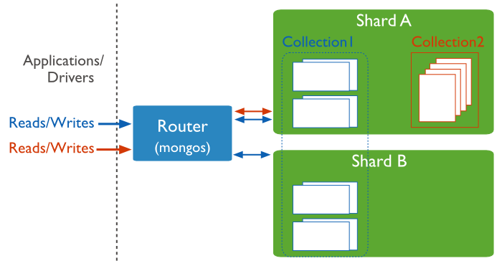
Sharding
Sharding is a method for storing data across multiple machines. MongoDB uses sharding to support deployments with very large data sets and high output operations. (provides high scalability)

Slide 12
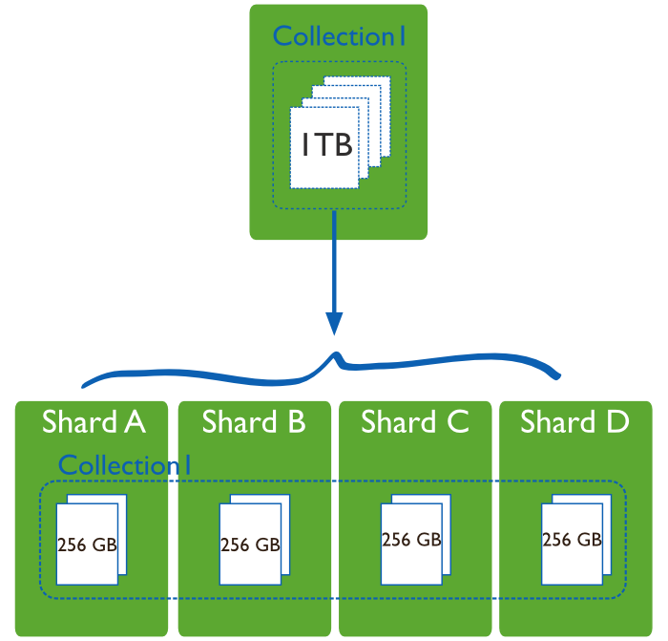
Vertical scaling vs Horizontal scaling
Vertical scaling adds more CPU and storage resources to increase capacity. Scaling by adding capacity has limitations: high performance systems with large numbers of CPUs and large amount of RAM are more expensive than smaller systems.
Sharding, or horizontal scaling, divides the data set and distributes the data over multiple servers, or shards. Each shard is an independent database, and collectively, the shards make up a single logical database.

Slide 13
Purpose of Sharding
Sharding reduces the number of operations each shard handles. Each shard processes fewer operations as the cluster grows. As a result, a cluster can increase capacity and output horizontally.
For example, to insert/read data, the application only needs to access the shard responsible for that record.
Sharding reduces the amount of data that each server needs to store. Each shard stores less data as the cluster grows.
For example, if a database has a 1 terabyte data set, and there are 4 shards, then each shard might hold only 256GB of data. If there are 40 shards, then each shard might hold only 25GB of data.

Slide 14
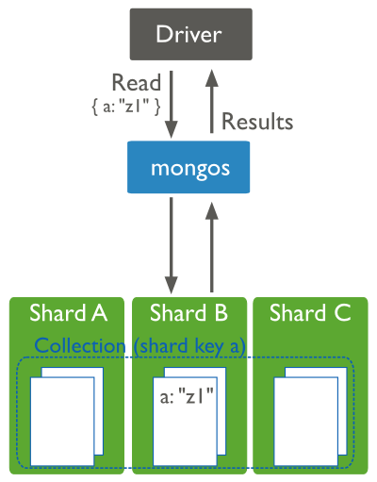
Sharding in MongoDB
Query Routers, or mongos instances, interface with client applications and direct operations to the appropriate shard or shards. (we can have more than 1 mongos)
Shards store the data. To provide high availability and data consistency, each shard can be a replica set.
Notes:
Config servers store the cluster metadata. The query router uses this metadata to target operations to specific shards.

Slide 15
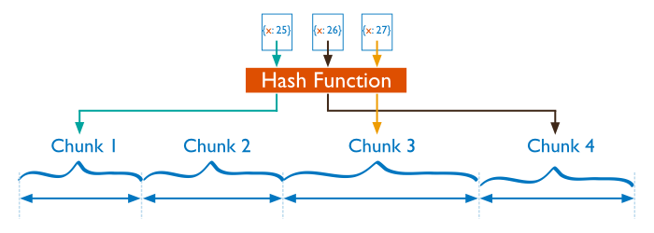
Data Partitioning
MongoDB distributes data, at the collection level. Sharding partitions a collection data by the shard key.
To shard a collection, you need to select a shard key. A shard key is an Indexed Field that exists in every document in the collection. MongoDB divides the shard key values into chunks and distributes the chunks evenly across the shards.
MongoDB uses either range based partitioning or hash based partitioning to divide the shard key values into chunks.
Notes:
Implications of sharding on development:
Every doc must include shard key
Shard key is immutable (you can't change it later)
Your index can be compound but it must start with shard key
When update: shard key should be specified OR multi: true (to distribute among shards if key wasn't available)
No shard key = scattered gather!
You can't have a unique key unless it start with the shard key

Slide 16
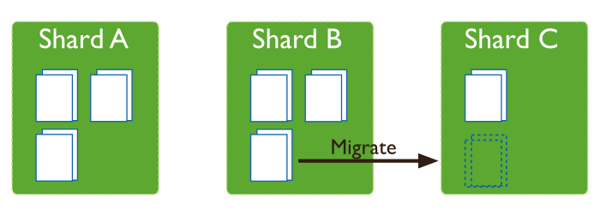
Adding and Removing Shards from the Cluster
Adding a shard to a cluster creates an imbalance since the new shard has no chunks. While MongoDB begins migrating data to the new shard immediately, it can take some time before the cluster balances.
When removing a shard, the balancer migrates all chunks from a shard to other shards. After migrating all data and updating the meta data, the shard will be removed.

Slide 17
Main Point
Horizontal scaling, divides the data set and distributes the data over multiple servers, or shards. Each shard is an independent database, and collectively, the shards make up a single logical database. Science of Consciousness: Life is found in layers.

Slide 18
connecting the parts of knowledge with the wholeness of knowledge
Processing data in the aggregation framework
The pipeline provides efficient data aggregation using native operations within MongoDB, and is the preferred method for data aggregation in MongoDB.
Aggregations operations process data records and return computed results. Aggregation operations group values from multiple documents together, and can perform a variety of operations on the grouped data to return a single result.
________________________________________________________________________________
Transcendental consciousness is when our mind is in contact with the deepest underlying reality, the unified field.
Impulses within the Transcendental field: the infinitely dynamism of the unified field constantly expresses itself and becomes all aspects of the universe.
Wholeness moving within itself: In Unity Consciousness, one experiences that this infinite dynamism is nothing but the self.

